Slide 1

Applied Data Science Capstone
Hannah Richards

Slide 2

Determine the severity of a car accident dependent on external factors

Slide 3
Introduction
Data provided by Seattle police department.
Dated from 2004 to present.
Recorded all collisions in this location and timeframe.
Some examples of factors:
Light conditions
Weather conditions
Road conditions

Slide 4

Understanding the data

Slide 5
Understanding the data
To understand the data better, we need to do some exploratory data analysis.
We can create visuals of the data. After doing some EDA we can see that most of the variables are categorical.
The target variable is the severity code column. Unfortunately, there are only two values in this column so we can make it a dummy variable.
On the next slides there are visualizations of the data so we can see what factors it is most correlated with.

Slide 6
Data preprocessing

Slide 7
Preparing the data
First, we will need to check how many null values there are in each column, speeding and under influence and X number.
We also need to one hot encode the data as it is categorical and will need this in order to feed it through the algorithm.
Then create a feature vector using the variables we have decided on. Calling this X.

Slide 8
Weather vs case severity number

Slide 9
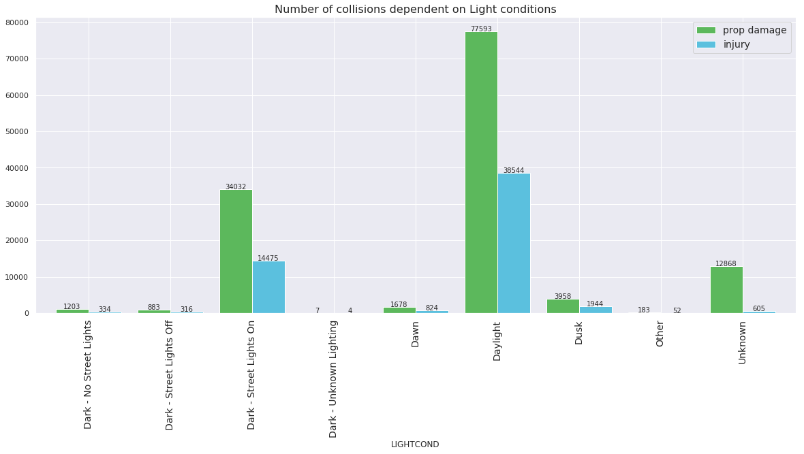
Light condition vs case severity number

Slide 10
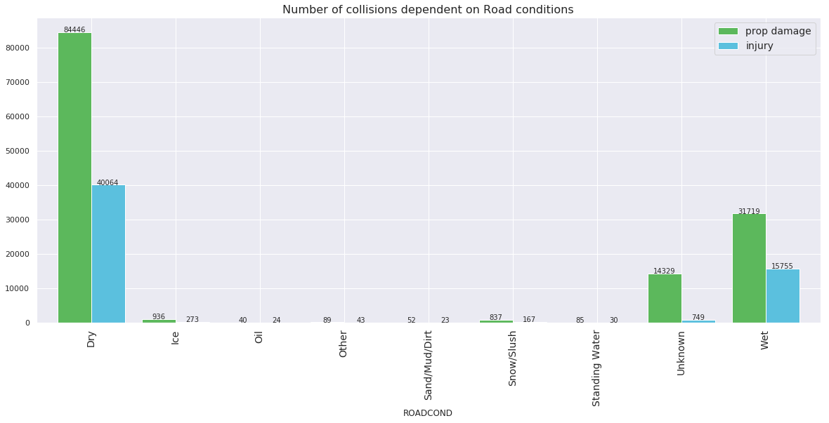
Road condition vs case severity number

Slide 11
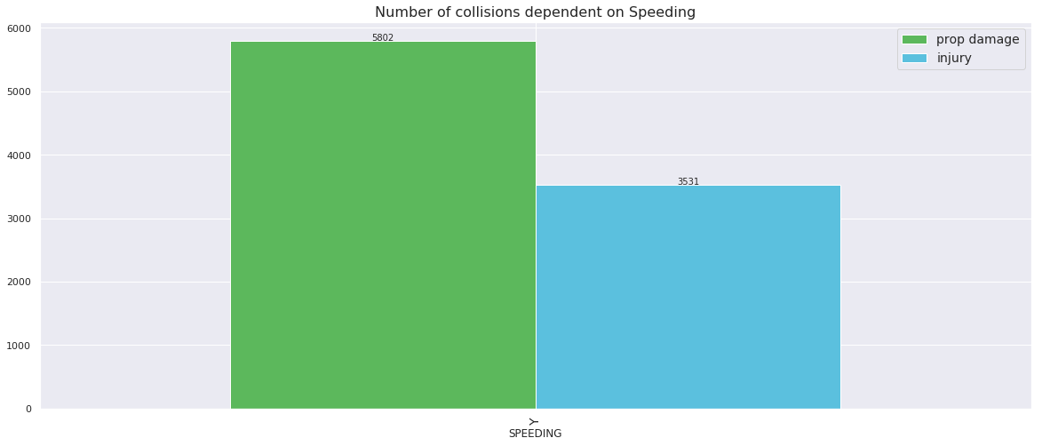
Speeding vs case severity number

Slide 12
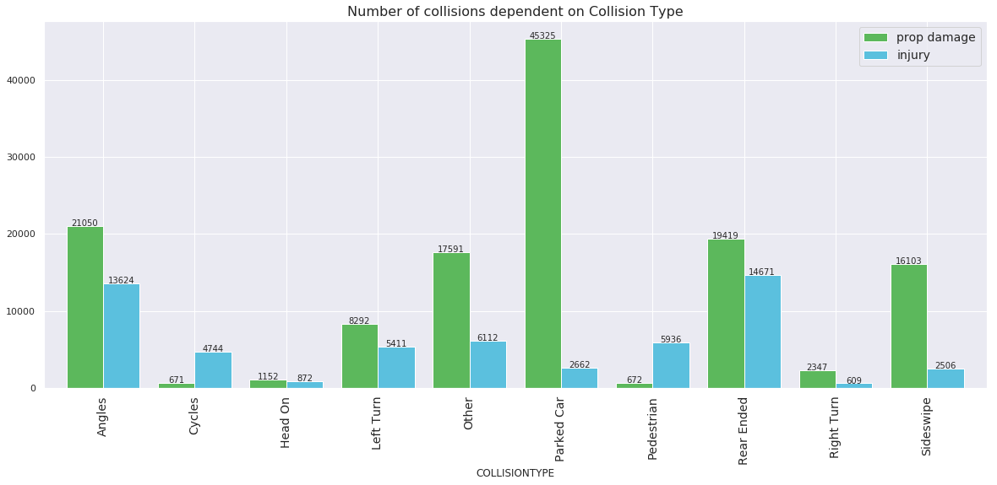
Collisions type vs case severity number

Slide 13
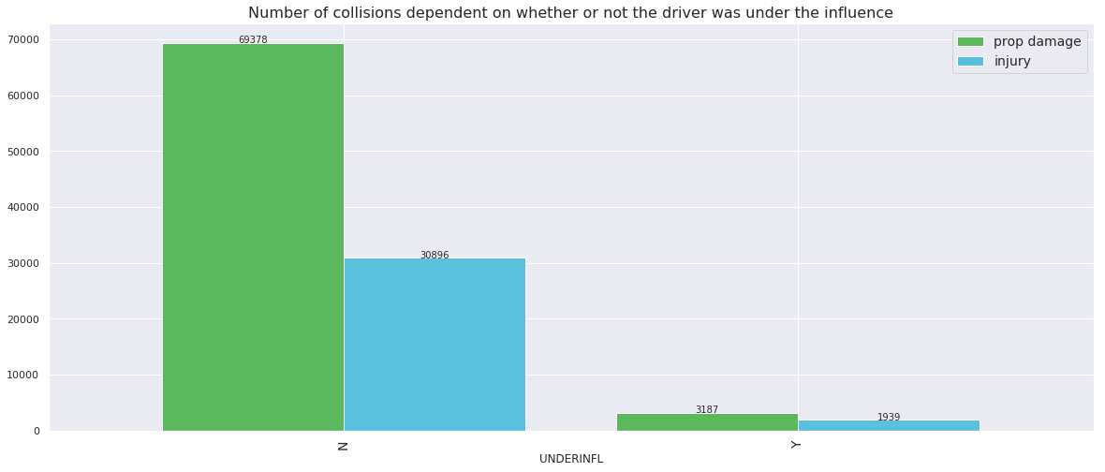
Whether driver was under influence or not vs case severity number

Slide 14

Data Standardisation

Slide 15
Data standardisation
We will now standardize the data to ensure that we capture the true values of the relationship between the variables.
Create a feature set
Standardise the target variable and then begin to model the data.

Slide 16

Modelling

Slide 17
Modelling
This is categorical data so I will model using K nearest neighbors, Support vector machine, decision trees and logistic regression. I have not chosen linear regression as that is only valuable on continuous regression.

Slide 18
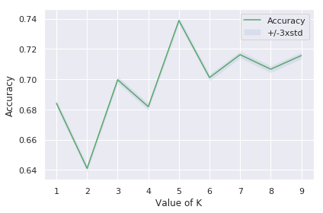
K-Nearest neighbors
I chose 5 for the value of K as this is where the accuracy is highest. While also not overfitting.

Slide 19
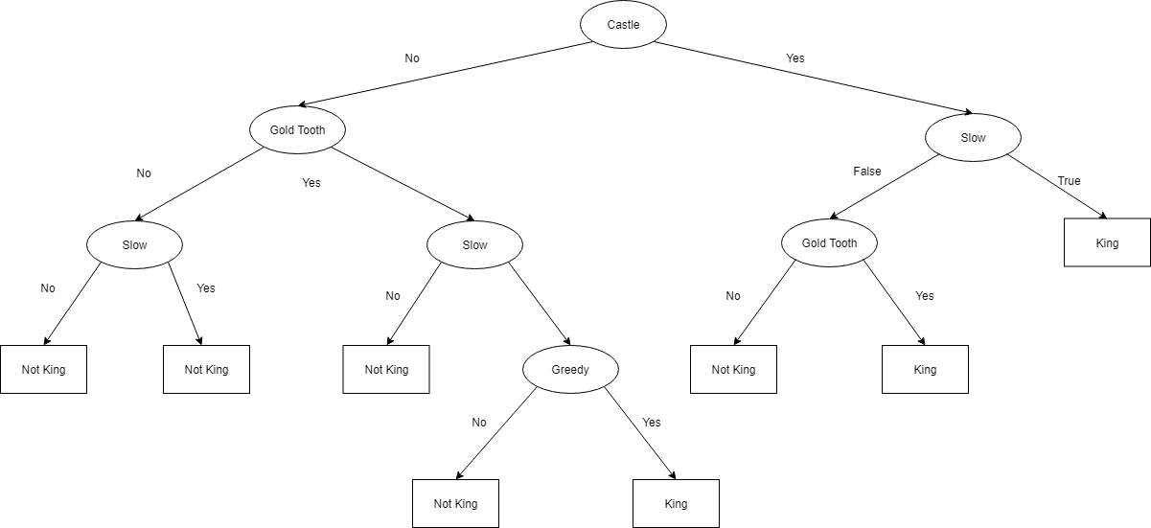
Decision Tree
I tried multiple depths for my decision tree algorithm, ranging from 4 to 39(the number of attributes in the model). The accuracy of the model did not change by altering the depth. Therefore to keep parsimony/simplicity, I decided to leave the algorithm at 4 ^{depth level.}

Slide 20
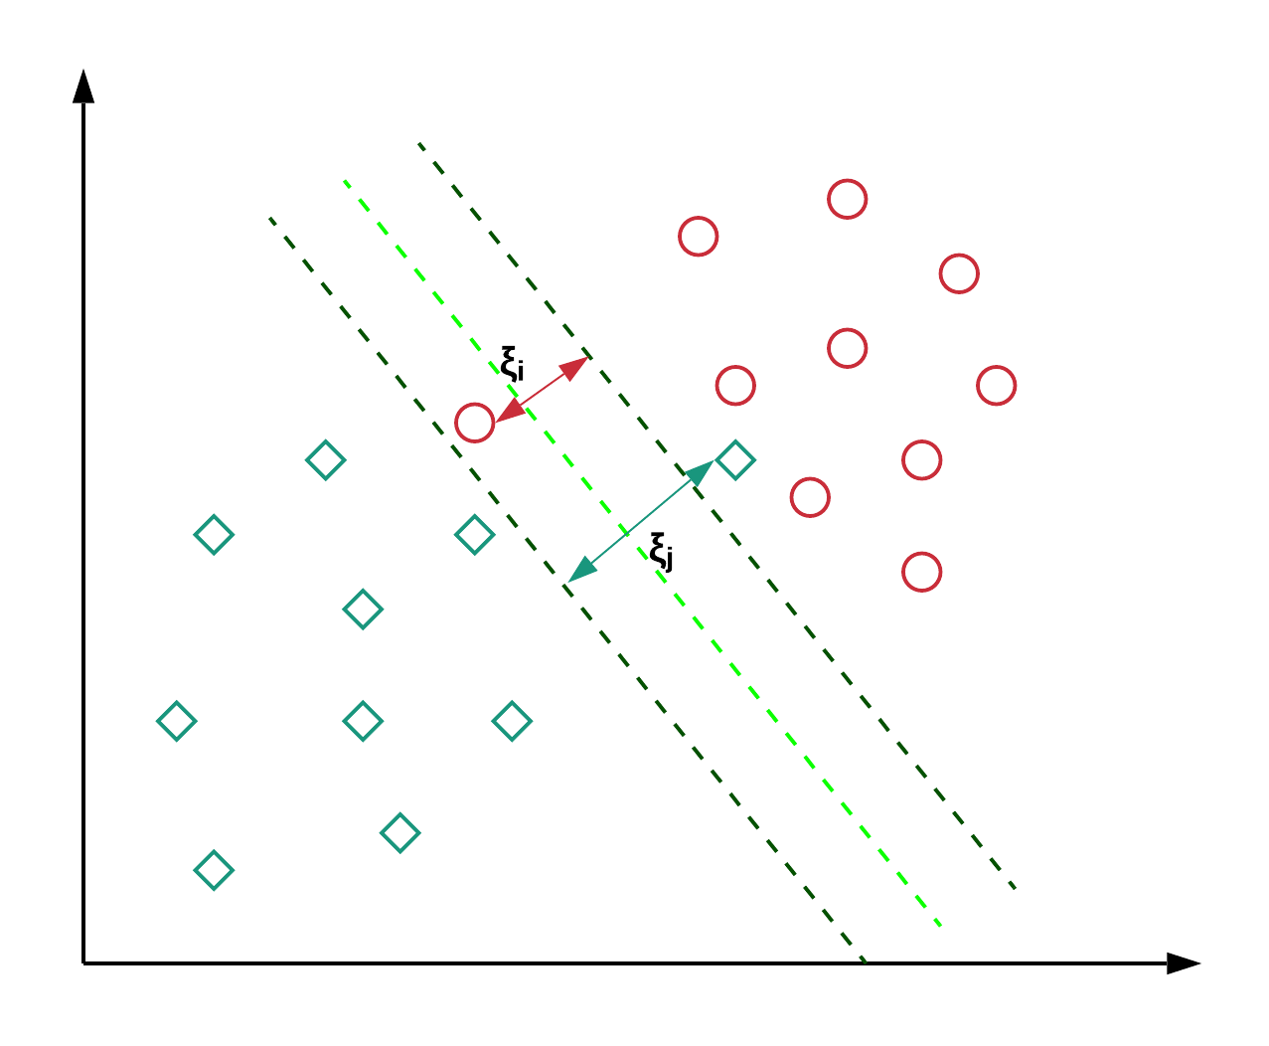
Support vector machine
I chose to use a support vector machine which fits the model by increasing the dimensionality of the model. Support vector machines (SVMs) are a set of supervised learning methods used for classification, regression and outliers detection.
Support vectors are the data points that lie closest. to the decision surface (or hyperplane) • They are the data points most difficult to classify. • They have direct bearing on the optimum location.

Slide 21
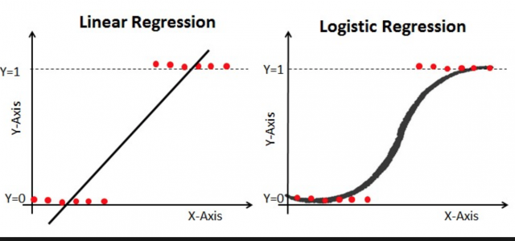
Logistic regression
I also fitted a logistic regression model to the data. Then evaluated this model with a log loss evaluation.

Slide 22
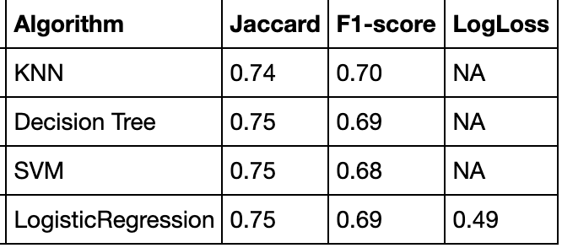
Accuracy
I will be using the F1 score and Jacquard matrix to validate accuracy. And for logistic regression I will be using log loss.

